Slide 1

Mobile Ad hoc Networks
Course title:
Wireless & Mobile Networks
Professor:
Dr. Zeinab MOVAHEDI

Slide 2
Mobile Ad Hoc Networks (MANET)
Definition & Challenges
No cellular infrastructure.
Multi-hop wireless links.
Data is routed via intermediate nodes.
Host movement frequent.
Topology change frequent.
Battery constraint
A
B
B
A

Slide 3

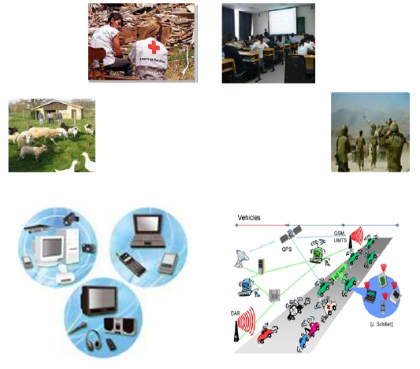

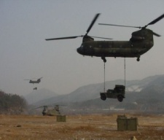
Mobile Ad Hoc Networks (MANET)
Applications

Slide 4
Dynamic Source Routing Protocol
Course title:
Wireless & Mobile Networks
Professor:
Dr. Zeinab MOVAHEDI

Slide 5
Features of DSR (1)
Specially designed for MANETs
Dynamically discover a source route to any destination.
Loop free routing
No routing information in the intermediate nodes
This routing information can be cached by other nodes forwarding or overhearing any of these packets

Slide 6
Features of DSR (2)
DSR has been integrated into
Standard Internet routing, where a gateway connected to the Internet also participates in MANET routing
Mobile IP routing, where such a gateway node also serves the role of a Mobile IP foreign agent
Supports internetworking between different types of wireless networks
Allows a source route to be composed of hops over a combination of any types of networks available

Slide 7
Assumptions (1)
All nodes willing to participate fully in the routing.
Network diameter will often be small (5 to 10 hops).
Moderate nodes speed with respect to the packet transmission latency & wireless transmission range.
Not making the flooding of every individual data packet the only possible routing protocol.
Each node selects a single IP address.

Slide 8
Assumptions (2)
Supporting uni-directional link.
due to differing antenna or propagation patterns or sources of interference around the two nodes
Nodes may be able to enable promiscuous receive mode on their wireless network interface.
Advantage: routing optimizations
Disadvantage: CPU overhead & power consumption
A receiving mode in which the hardware delivers every received packet to the network driver software without filtering based on link-layer destination address.

Slide 9
DSR Mechanisms
Route discovery
Route maintenance
The mechanism by which a node S wishing to send a packet to a destination node D obtains a source route to D.
Route Discovery is used only when S attempts to send a packet to D and does not already know a route to D.
The mechanism by which node S is able to detect, while using a source route to D, if the network topology has changed such that it can no longer use its route to D because a link along the route no longer works.
Route Maintenance is used only when a route is in use

Slide 10
DSR strengths
Both mechanisms “on-demand”
No periodic routing advertisement, No link status sensing, No neighbor detection packets
Low overhead, scalability
Routes caching in many of nodes for each single route discovery or through overhearing
Rapid reaction to routing changes
Low overhead

Slide 11
Basic DSR Route Discovery
S requires a route to D
S searches its route cache to find a source route to D
If found, it sends its message with the source route in cache
Otherwise, it initiates a Route Request (RREQ) to dynamically find a new route to D (S: Initiator, D: Target of the Route Discovery)

Slide 12
Basic DSR Route Discovery RREQ phase (1)
S saves a copy of the original packet in a Send Buffer
S sends a RREQ message
<Initiator node S, Target node D, Unique request id, A source route record initialized to an empty list by the initiator>
3) RREQ is send as a single local broadcast packet
Received by (approximately) all nodes currently within wireless transmission range of S

Slide 13
Basic DSR Route Discovery RREQ phase (2)
When another node receives a RREQ
if the target of the Route Discovery
Returns a Route Reply (RREP) to the initiator, giving a copy of the accumulated route record from RREQ.
Otherwise, if this node has recently seen another RREQ from this initiator with same request id, or if its own address is already listed in the route record in the RREQ, it discards the RREQ.
Otherwise, this node appends its own address to the route record in the RREQ and propagates it by transmitting it as a local broadcast packet (with the same request id).

Slide 14
Basic DSR Route Discovery RREP phase (1)
D examines its own Route Cache for a route back to S
if found, uses it as the source route for delivery of RREP.
Otherwise,
Piggybacking RREP in a new RREQ packet for S
E/D may reverse the route in RREQ, and use this as the source route of the RREP itself (if bidirectional links).
When the initiator receives RREP, it caches this route in its Route Cache

Slide 15
Basic DSR Route Discovery send buffer (1)
Send Buffer contains a copy of packets waiting for a source route stamped with the time of placement into the send Buffer
A packet is discarded from send buffer
After expiration of the timer
By a FIFO or other replacement strategy to prevent the Send Buffer from overflowing

Slide 16
Basic DSR Route Discovery send buffer (2)
Reinitiate a new RREQ for a packet remaining in the send buffer
This RREQ re-initiation should have a limited rate to reduce the overhead of inutile RREQs towards a same target
since the destination node may not currently be reachable (due to network partitioning)
RREQs towards a same target should be distanced by an exponential back-off.
If the node have additional data packets to the same target more frequently than this limit, the subsequent packets should be buffered until a RREP is received.

Slide 17

Basic DSR Route Discovery example
Represents a node that has received RREQ for D from S
S
E
F
B
C
M
L
J
A
G
H
D
K
I
N

Slide 18
Basic DSR Route Discovery example
Represents transmission of RREQ
[X,Y] Represents route record stored in RREQ
Broadcast
[S]
S
S
E
E
F
F
B
B
C
C
M
M
L
L
J
J
A
A
G
G
H
H
D
D
K
K
I
I
N
N

Slide 19
Basic DSR Route Discovery example
Node H receives packet RREQ from two neighbors:
potential for collision
S
S
E
[S,E]
E
F
F
[S,B]
B
B
C
C
M
M
L
L
J
J
A
A
G
[S,C]
G
H
H
D
D
K
K
I
I
N
N

Slide 20
Basic DSR Route Discovery example
C receives RREQ from G and H, but does not forward
it again, because C has already forwarded RREQ once
S
S
E
E
F
F
[S,E,F]
B
B
C
C
M
M
L
[S,B,A]
L
J
J
A
A
G
G
H
[S,B,H]
H
D
D
K
K
I
[S,C,G]
I
N
N

Slide 21
Basic DSR Route Discovery example
J and K both broadcast RREQ to D
Their transmissions may collide at D
S
S
E
E
F
F
[S,E,F,J]
B
B
C
C
M
M
L
L
J
J
A
A
G
G
H
H
D
[S,B,H,I]
D
K
K
I
I
N
[S,C,G,K]
N

Slide 22
Basic DSR Route Discovery example
D does not forward RREQ, because D is the intended target
S
S
E
E
F
[S,E,F,J,M]
F
B
B
C
M
L
C
M
L
J
J
A
G
A
G
H
D
H
D
K
K
I
N
I
N
D does not forward RREQ, because D is the intended target

Slide 23
Basic DSR Route Discovery example
Represents RREP control message
S
S
E
RREP [S,E,F,J,D]
E
F
F
B
B
C
M
L
C
M
L
J
J
A
G
A
G
H
D
H
D
K
K
I
N
I
N

Slide 24
Additional Route Discovery features Caching extra routing information
Caching forwarding/overheard routing information
Source route in data packet
Accumulated route in RREQ
Route returned in RREP
Considering uni-directional links

Slide 25
Additional Route Discovery features Replying to RREQ using cached routes
The intermediate node must verify that the resulting route being returned contains no duplicate nodes listed in the route record
To ensure that RRER achieves all intermediate nodes
Next RREQ not contaminated by RREP with the same stale route
The route record in RREP, concatenation of
Route over which this copy of RREQ was forwarded to it
The route in its cache from itself to the target

Slide 26
Additional Route Discovery features Preventing Route Reply storms
Many RREP could be send to A from A’s neighbors
bandwidth waste & local congestion
A node sends RREP only if it does not overhear within a time that the originator begining a data transfer using a shorter route
delay random period d = H(h - 1 + r)
expires faster for nodes with shorter route
requires the promiscuous mode

Slide 27
Additional Route Discovery features Route Request Hop Limit
Limiting the number of allowed hops for RREQs
Non-propagating RREQ (hop limit = 0)
determining if the destination is a neighbor of originator
using a neighbor cache as an extension of the originator cache
Expanding ring search
non-propagating RREQ
hop limit = 1
hop limit doubled if no RREP
increases the average latency

Slide 28
Basic DSR Route Maintenance (1)
Node transmitting the packet responsible for confirming the packet reception by next hop
Receipt confirmation
At no cost to DSR
lower layer protocol MAC (Link layer acknowledgment frame defined by IEEE 802.11)
Passive acknowledgment – overhearing
DSR-specific software ack
A bit set to packet header to request such an ack

Slide 29
Basic DSR Route Maintenance (2)
No receipt confirmation after the maximum number of retransmission
Route Error (RERR) message to the original sender identifying the broken link
Upon reception of RERR, the original sender removes this broken link from its cache

Slide 30
Basic DSR Route Maintenance (3)
When S receives a RERR
S can attempt to use any other route it happens to know to D
S can invoke Route Discovery again to find a new route

Slide 31
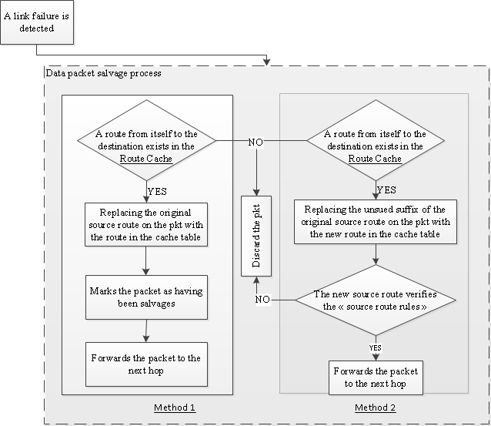
Additional route maintenance features packet salvaging
Salvage the data packet causing the RERR to avoid discarding it
Method 1
possible routing loop (avoided by marking
the salvaged packets to prevent from being
salvaged multiple times)
Method 2
no routing loop (source route rules verified)
back-tracking not possible

Slide 32
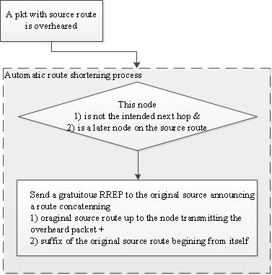

Additional route maintenance features
Automatic Route Shortening
Automatically shortening a source route in use if one or more intermediate hops in the route become no longer necessary

Slide 33
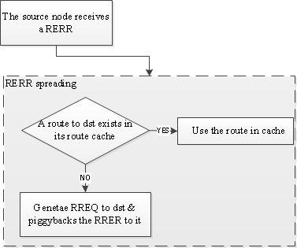
Additional route maintenance features increasing spreading of RERR (1)
Prevent stale information in caches of nodes around the source from generating RREPs with the same invalid link

Slide 34
Additional route maintenance features increasing spreading of RERR (2)
Node S receiving the RERR forwards the RERR over the same source route resulted in RERR.
Guarantee that the RERR reaches the node generating the RREP containing the broken link.
Prevent the contamination of a future Route Discovery with the same broken link.

Slide 35
Additional route maintenance features
caching negative information
Caching the negative information of a broken link (or highly variable link) during an expiration timer instead of just removing entries with the broken/variable link from its route cache
Do not accept RREPs containing the bad link
Expiration timer allows reusing links beginning to work again

Slide 36
Support for heterogeneous networks
A subset of nodes with two types of interfaces
short range & long range (generally lower speed)
e.g. a group of soldiers communicating among themeselves using short-range radios and with other groups through truck-mounted higher power radios
communicating with nodes further away without requiring large number of hops
span gaps between different groups to avoid network partition

Slide 37

Support for heterogeneous networks
Each node chooses only one of its interfaces as home address
treat the overall network as a single routing domain
interfaces distinguished using a locally unique interface index
interface index as part of each hop in the sourece route ($N_{k}/i_{k}$ indicates that the node $N_{k}$ must transmit packet using network interface $i_{k}$ to deliver the packet to the next hop $N_{k+1}$)
Source route: A/1→B/1→C/4→D/1 Reverse route: D/1→C/4→B/2→A/1

Slide 38
Internet interconnection and Mobile IP (1)
Seamless interoperation between MANET and Internet
allow transparent routing of packets between MANET and Internet
Support the mobility of nodes between MANET and Internet
one or more gateway nodes
nodes in MANET connected also to Internet which participate in MANET through DSR and in Internet through IP routing
dynamically enlarge the coverage range around a wireless Internet base station through MANET
act as a Mobile IP home/foreign agent

Slide 39
Internet interconnection and Mobile IP (2)
2 special reserved interface indexes for gateway nodes
Gateway node with two separate physical interfaces
reserved interface indexes identify the physical Internet interface
Gateway node with single physical network interface
reserved interface indexes identify the logical Internet interfaces
Interface index value for a network interface of a gateway node
if a Mobile IP mobility agent on that interface: IF_INDEX_MA
Allow mobility agents to advertise their existence with no cost
A node receiving a routing header containing the interface index IF_INDEX_MA can send a unicast Mobile IP Agent SOLICITATION to the corresponding address in the routing header to obtain complete information about Mobile IP services
otherwise: IF_INDEX_Router

Slide 40
Internet interconnection and Mobile IP (3)
When a gateway node receives a RREQ
generates a RREP with its reserved interface index to Internet if it belives it can reach the destination through its Internet connection
originator may receive a RREP from both the gateway and the destination if it is present in the MANET
originator should prefer cached routes not traversing a hop with interface index IF_INDEX_MA or IF_INDEX_ROUTER

Slide 41
Multicast routing with DSR
DSR piggybacks the data of the multicast application inside a RREQ targeted at the multicast address
the RREQ is propagated to all nodes within the specified hop count (TTL) of the originator
each receiving node individually examines the destination address of the packet and discards the packet if this node is not subscribed to that multicast address
An approximation of multicast routing
Does not support pruning of the broadcast tree to conserve network resources

Slide 42
DSR Evaluation
Parameter | Value
Number of nodes | 50
Simulation area | 1500*300 m2
Number of connections | 10, 20, 30
Traffic type | CBR
Traffic rate | 4 packets/s
Simulation time | 900 s
Mobility model | RWP
Nodes speed | 1 m/s, 20 m/s
Radio characteristics | Lucent WaveLAN
MAC layer | IEEE 802.11
Number of runs | 10
Simulation
ns-2

Slide 43
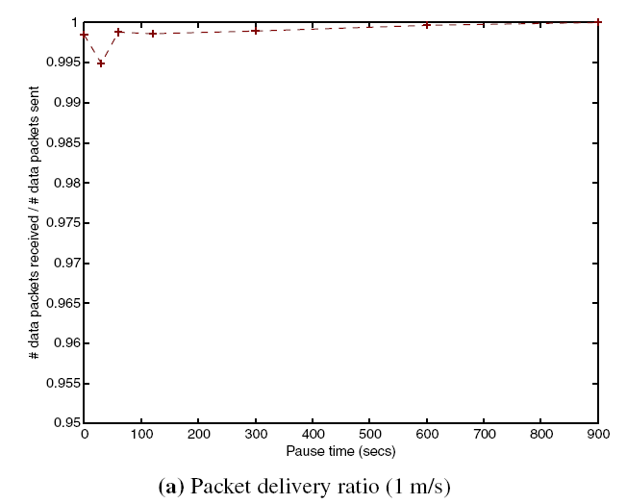
DSR Evaluation: simulation results

Slide 44
DSR Evaluation: simulation results

Slide 45
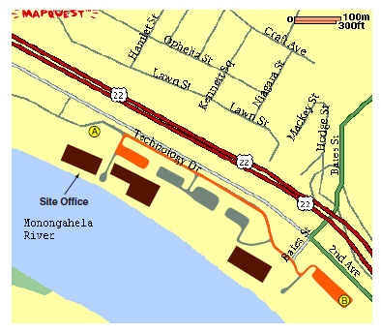
DSR Evaluation: testbed scenario
freeBSD version of Unix
DSR packets encoded as option of IP header
Carnegie Mellon University
Daily during 4 months
5 mobile nodes moving at 10 m/s in an area open to other vehicles with several stop signes
2 stationary nodes separated by 700 m (3 hops)
Bulk file transfer, telnet, CBR (video & voice), real-time position reporting packets

Slide 46
DYNAMIC SOURCE ROUTING
(DSR) PROTOCOL
OPEN DISCUSSION

